Slide 1



Notes:
Welcome. In this presentation, we will explain the command line interface to the Provengo tool.

Slide 2
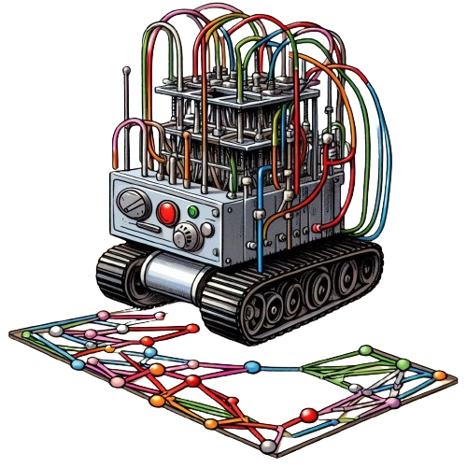
$ provengo
/\
/XX\
{XXXX#####################################
\XX/ / _ \_______ _ _____ ___ ___ ___
\/ / ___/ __/ _ \ |/ / -_) _ \/ _ \/ _ \
/_/ /_/ \___/___/\__/_//_/\_, /\___/
/___/
usage: provengo [-h] [--verbose] [--batch-mode] [--no-color] [--config CONFIG] [-p PROFILE] [-c [CUSTOM]] [-v]
{run,analyze,gen-scripts,gen-js,report,combi,sample,ensemble,gen-book,create} ...
provengo: error: too few arguments
Notes:
Assuming the tool is installed on your system, you can run it by opening a terminal and typing ‘provengo’. Upon doing so, you will receive a message indicating “too few arguments” and an explanation of the available commands. We will now delve into the main options and their usage.

Slide 3
$ provengo [global options] sub-command [sub-command options] <path-to-project>
Notes:
The Provengo tool operates through a sub-command, which instructs it on the specific task to perform and the project to apply it to.

Slide 4
$ provengo [global options] sub-command [sub-command options] <path-to-project>
--batch-mode Skips user interactions.
--config PATH Specifies the configuration file to use, defaulting to `provengo.yml`.
--no-color Outputs plain text without console colors.
-p/--profile NAME: Defines the profile name as per the configuration file.
--verbose Provides detailed console data, useful for project debugging.
-c key=value/--custom key=value: Allows explicit setting of configuration keys from the command line.
Notes:
Global options apply to all sub-commands.

Slide 5
$ provengo [global options] sub-command [sub-command options] <path-to-project>
--batch-mode Skips user interactions.
--config PATH Specifies the configuration file to use, defaulting to `provengo.yml`.
--no-color Outputs plain text without console colors.
-p/--profile NAME: Defines the profile name as per the configuration file.
--verbose Provides detailed console data, useful for project debugging.
-c key=value/--custom key=value: Allows explicit setting of configuration keys from the command line.
Notes:
For our course, the most useful among them is the ‘verbose’ option. This option instructs the tool to generate more descriptive messages, which can be helpful in identifying and resolving issues with our models.

Slide 6






$ provengo [global options] sub-command [sub-command options] <path-to-project>
create
run
analyze
sample
ensemble
report
Notes:
The sub-command argument can be thought of as the system’s main menu, guiding us through various operations:

Slide 7
$ provengo [global options] sub-command [sub-command options] <path-to-project>
create
run
analyze
sample
ensemble
report
Notes:
“Create” initiates a new project.

Slide 8
$ provengo [global options] sub-command [sub-command options] <path-to-project>
create
run
analyze
sample
ensemble
report
Notes:
“run” executes a project.

Slide 9
$ provengo [global options] sub-command [sub-command options] <path-to-project>
create
run
analyze
sample
ensemble
report
Notes:
“analyze” generates a state graph for the project.

Slide 10
$ provengo [global options] sub-command [sub-command options] <path-to-project>
create
run
analyze
sample
ensemble
report
Notes:
“Sample” creates a set of tests for the project.

Slide 11
$ provengo [global options] sub-command [sub-command options] <path-to-project>
create
run
analyze
sample
ensemble
report
Notes:
“ensemble” optimizes the test suite for the project.

Slide 12
$ provengo [global options] sub-command [sub-command options] <path-to-project>
create
run
analyze
sample
ensemble
report
Notes:
“report” compiles a detailed report of the executed tests, including their pass/fail status.

Slide 13
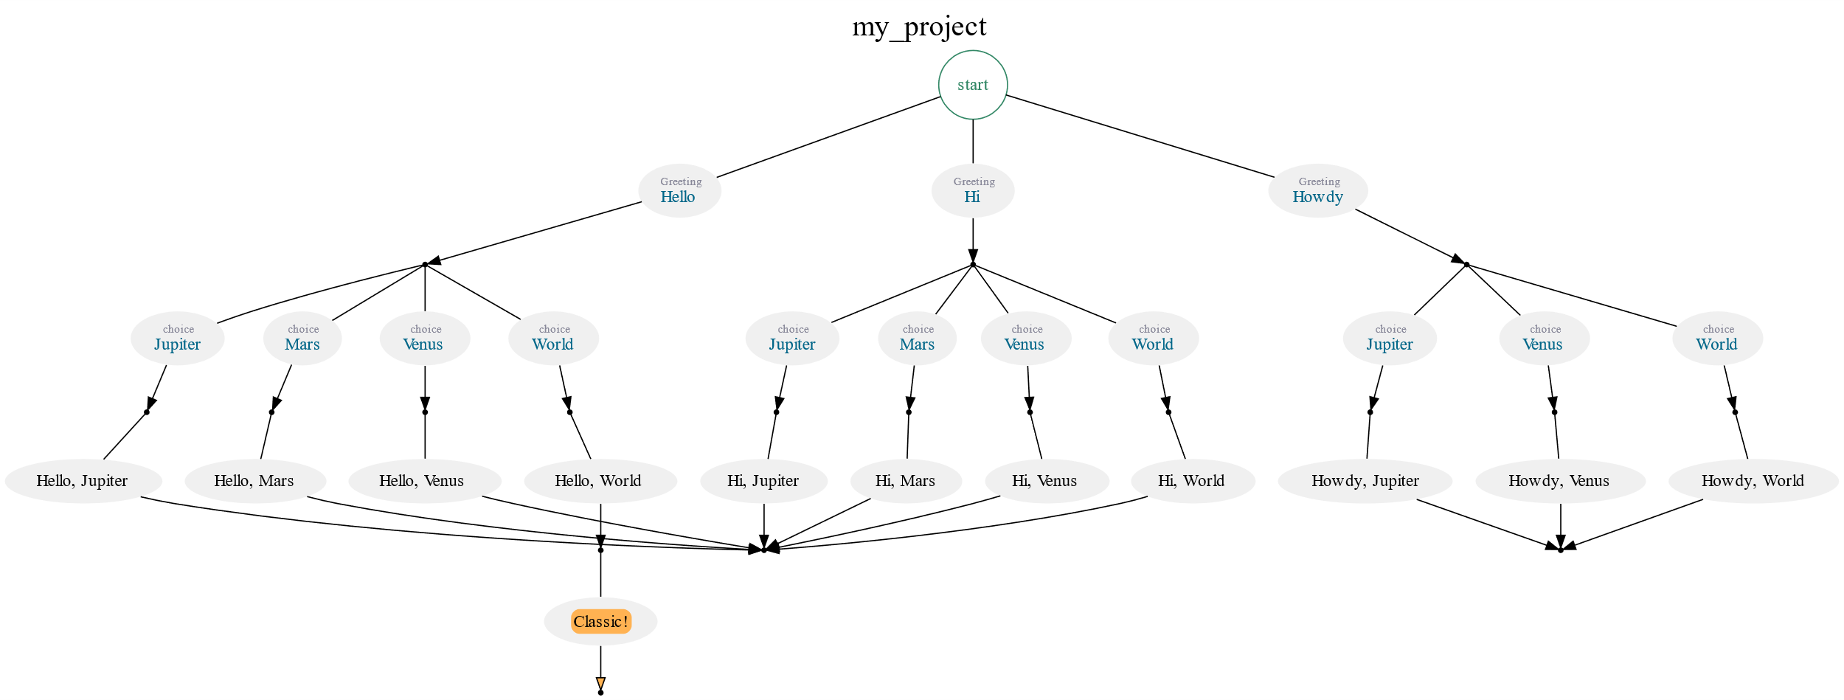
$ provengo --batch-mode create my_project
/\
/XX\
{XXXX#####################################
\XX/ / _ \_______ _ _____ ___ ___ ___
\/ / ___/ __/ _ \ |/ / -_) _ \/ _ \/ _ \
/_/ /_/ \___/___/\__/_//_/\_, /\___/
/___/
[SETUP] INFO Project folder: /my_project
$ provengo run my_project
/\
/XX\
{XXXX#####################################
\XX/ / _ \_______ _ _____ ___ ___ ___
\/ / ___/ __/ _ \ |/ / -_) _ \/ _ \/ _ \
/_/ /_/ \___/___/\__/_//_/\_, /\___/
/___/
[SETUP] INFO Input path: /my_project
[RUN ] INFO Preparing to run
[RUN>random] INFO Selected: [Greeting: Howdy {JS_Obj type:"selection", name:"Greeting", value:"Howdy", lib:"bp-base"}]
[RUN>random] INFO B-program started
[RUN>random] INFO Selected: [Choice: Jupiter {JS_Obj type:"choice", value:"Jupiter", lib:"bp-base"}]
[RUN>random] INFO Selected: [Howdy, Jupiter]
[RUN>random] INFO Super-step done
[RUN ] INFO Test Result: SUCCESS
$ provengo analyze -f pdf my_project
/\
/XX\
{XXXX#####################################
\XX/ / _ \_______ _ _____ ___ ___ ___
\/ / ___/ __/ _ \ |/ / -_) _ \/ _ \/ _ \
/_/ /_/ \___/___/\__/_//_/\_, /\___/
/___/
[SETUP] INFO Input path: /my_project
[ANLYZE] INFO Max DFS depth: defaulting to 60
[ANLYZE] INFO Found 19 states, connected by 26 edges.
Notes:
Here, we see a sequence of commands that creates a new project, runs it, and creates a visualization of the model. We will learn how to use these commands in the course and how to edit the model for testing our system.

Slide 14
Notes:
This concludes our presentation. We’ve seen how the command line interface can be used to work with the Provengo tool.

